Slide 1
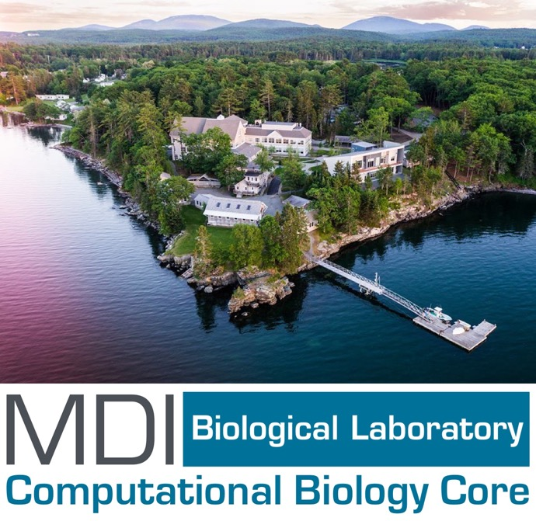
Workflows in the Cloud
MDI Biological Laboratory
2nd May, 2025
Saba Nafees, Ph.D.
MemVerge, Nextflow Ambassador

Slide 2

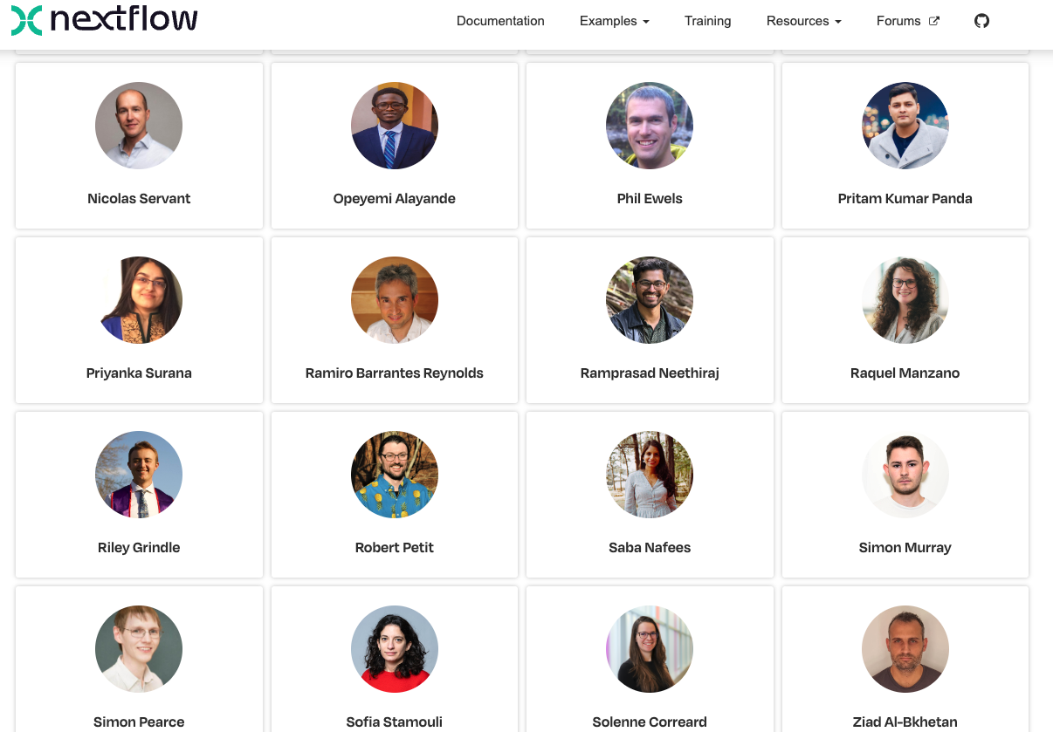
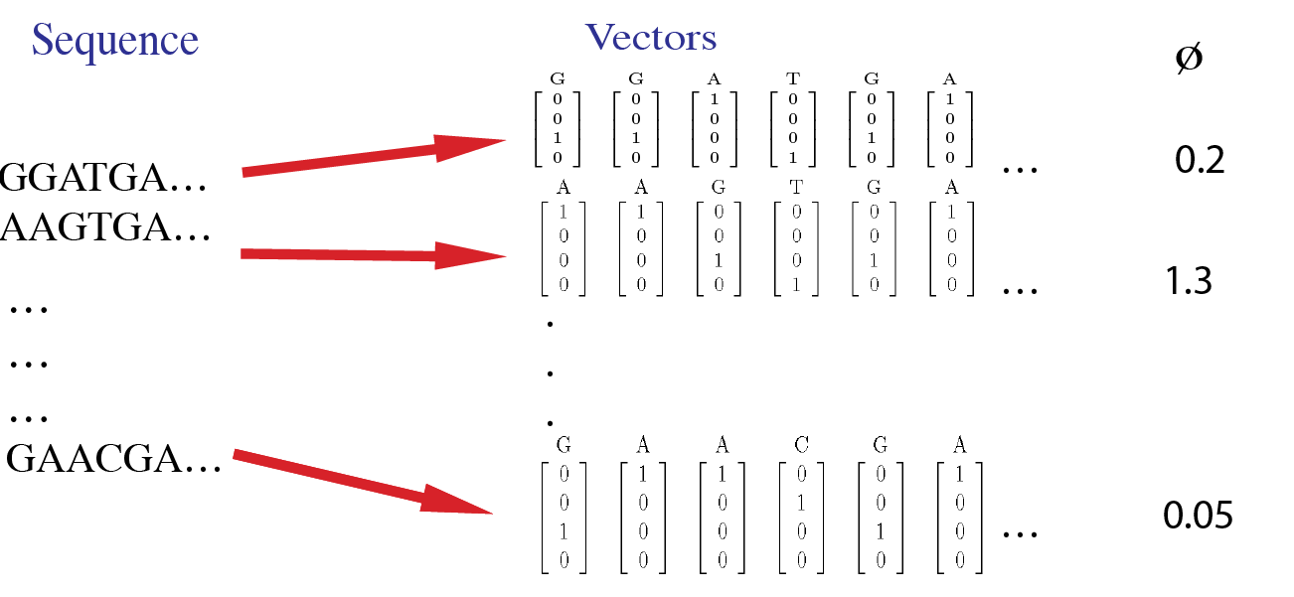


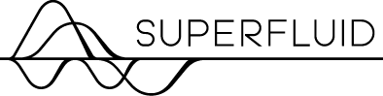

Background
Research: Understanding sequence–phenotype relationships using novel analytical methods.
Bioinformatics (analysis, pipeline development & optimization, etc.); computational biology problems (gene expression, immune/antibody analysis, etc.); methods development.
community building (nf-core), training/teaching, and mentorship!
Basis of ortho_seqs work
https://www.nextflow.io/our_ambassadors.html

Slide 3







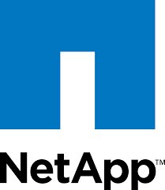






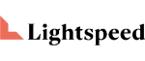



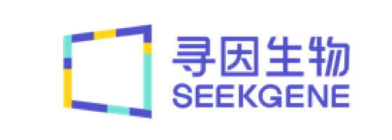



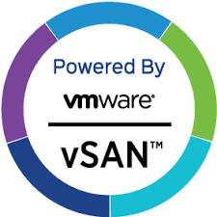




Little bit about MemVerge…
Raised ~$100M of investment
Headquarters in San Jose, CA
Software is used by genomics customers in four continents
Launched Memory Machine for AWS at re:Invent 2022
Founders created
$B product lines
Award winning solution helps automate & lower the cost of running genomics workloads on AWS
Europe
USA
MemVerge Confidential
Notes:
Launched Memory Machine Cloud in December 2022
Deployed in 3 continents
Dozens of Production Customers

Slide 4
Running pipelines at scale while optimizing resources
Running multiple pipelines at scale, given lots of sequence samples and limited resources can be a bottleneck for R&D.
Notes:
my slide from a previous deck for seqera https://docs.google.com/presentation/d/1w63Rvhe32GHsTKeHLlufYHNuDxZLvg5tKL1MQjPdKsg/edit#slide=id.g28b00505104_0_1

Slide 5

Have you used EC2 Spot instances?
First the benefits…
Customers have saved over $8B
EC2 Spot prices can be 50-80% less vs. On-Demand

Slide 6

Spot instances introduce unpredictability
Costs can end up being higher than just running with on-demand instances
Runtimes can be much longer when jobs are interrupted, 2-minute warning

Slide 7
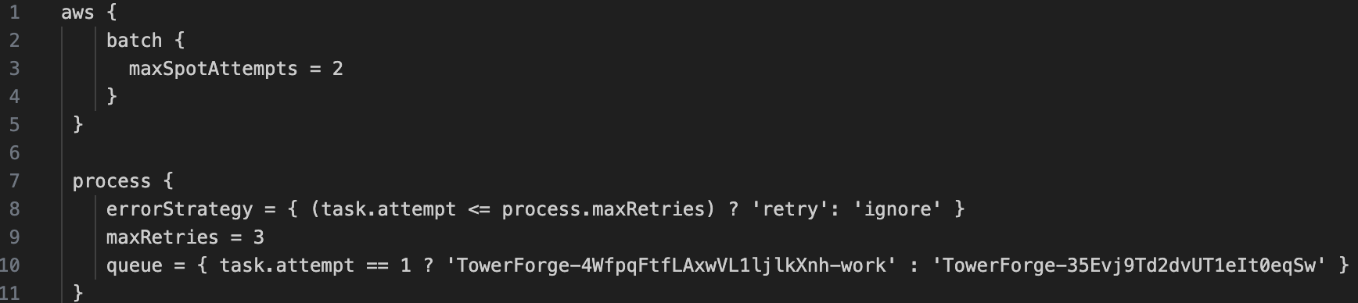
Pain Point: Spot reclamations & long runtimes
Use case example:
Molecular diagnostics startup working on cell free mRNA assay for Alzheimer's
running nf-core rnaseq pipeline on samples
need fast turnaround times for bioinformatics analysis + results
analysis informs further iterations of assay
without results, subsequent experiments are delayed
pipeline runs monitored on Seqera, spot reclamations led to increased runtimes
hybrid strategy of switching to OnDemand (Nextflow config) reduced failures.
cost & time optimization was key
spot instance
ondemand
Notes:
Reduce the # of spot attempts under the hood. Error strategy
Retry
Ignore
Tell nextflow to go from spot to ondemand after 1 attempt so that resource consuming tasks can be done via ondemand
Spot Instances: unused EC2 instances, which can reduce your Amazon EC2 costs significantly. On-Demand Instances: Pay for the instances that you use by the second, with a minimum of 60 seconds, with no long-term commitments or upfront payments.

Slide 8
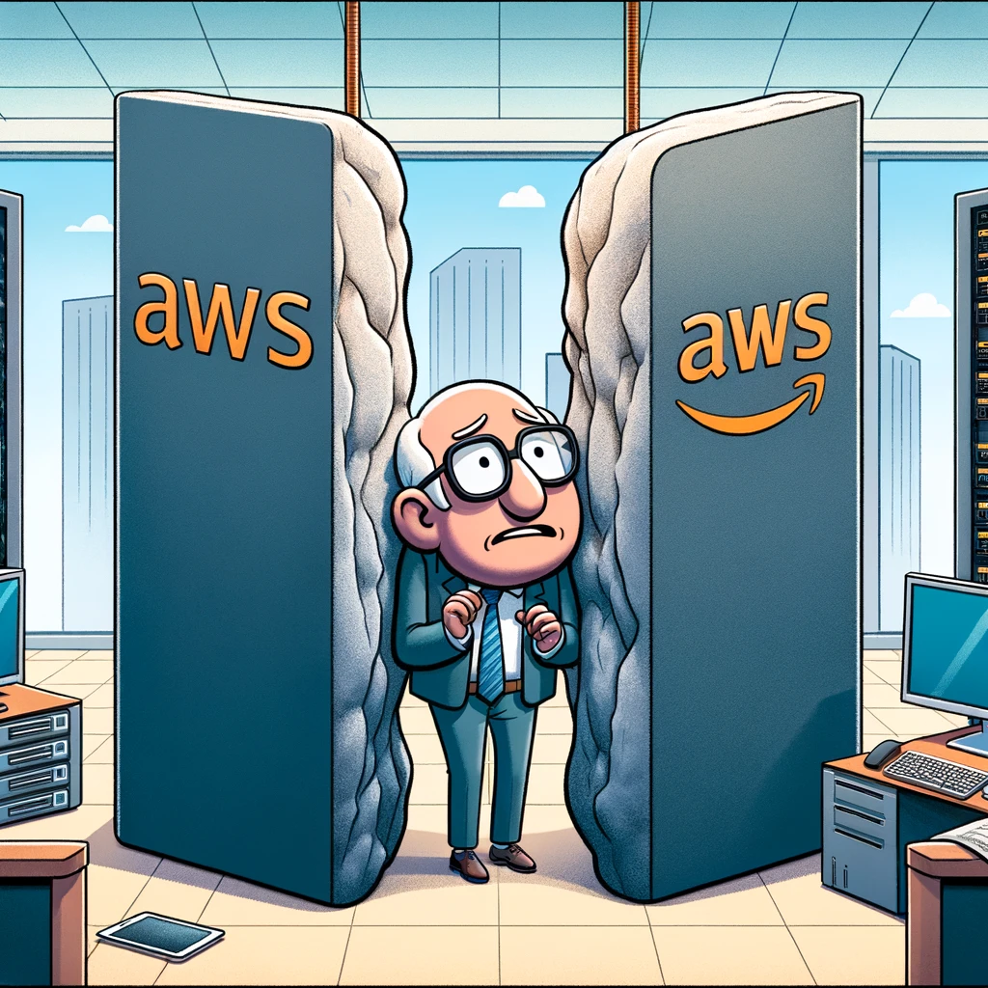
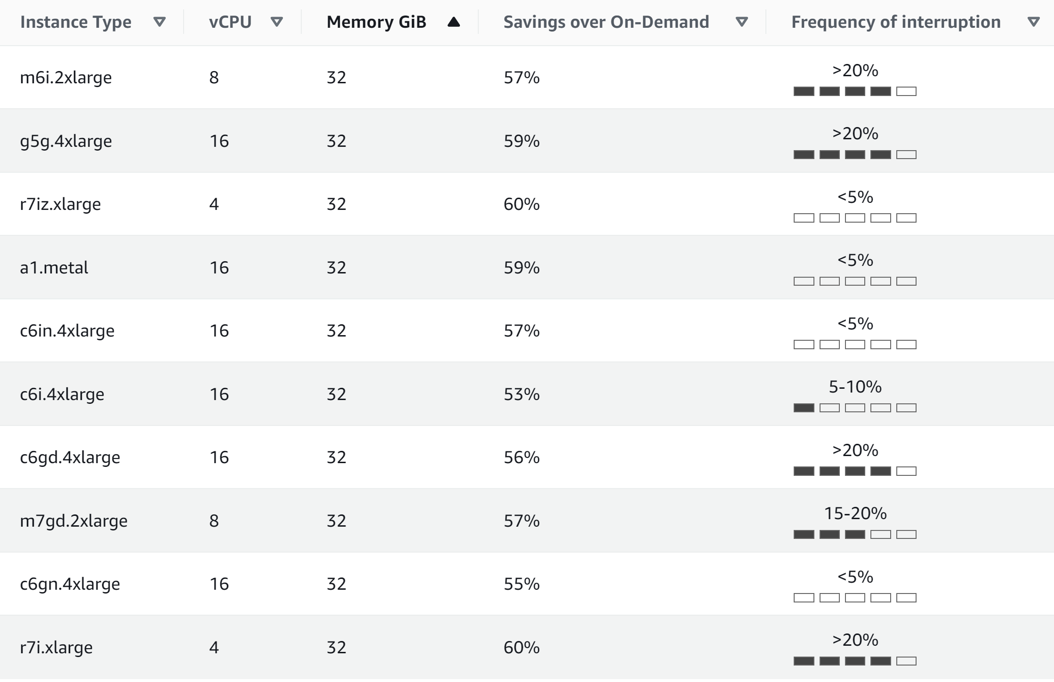
Pain Point: Cloud Costs
“Stuck between a rock and a hard place”
“Savings vs. On-Demand vs. Interruption Frequency”
On-Demand $$$ no commitment
Reserved Instances $$ long term commit
Cloud Savings Plans $$ long term commit
Spot Instances $? no commitment
Notes:
It can be hard to forecast in advance exactly how much compute is needed for an NIH project. The only commitment free options are expensive On-Demand instances or “unreliable” Spot instances.
EC2 Spot discounts are typically 50% or more vs. On-Demand, but interruption frequency can erode real savings as well as delay time to results

Slide 9
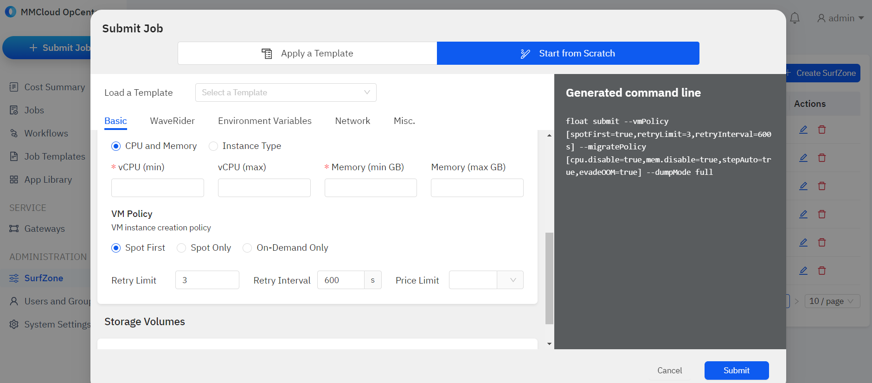
We make running on Spot simple…and…
Notes:
because we spotsurf, we take care of moving from spot to spot easy

Slide 10
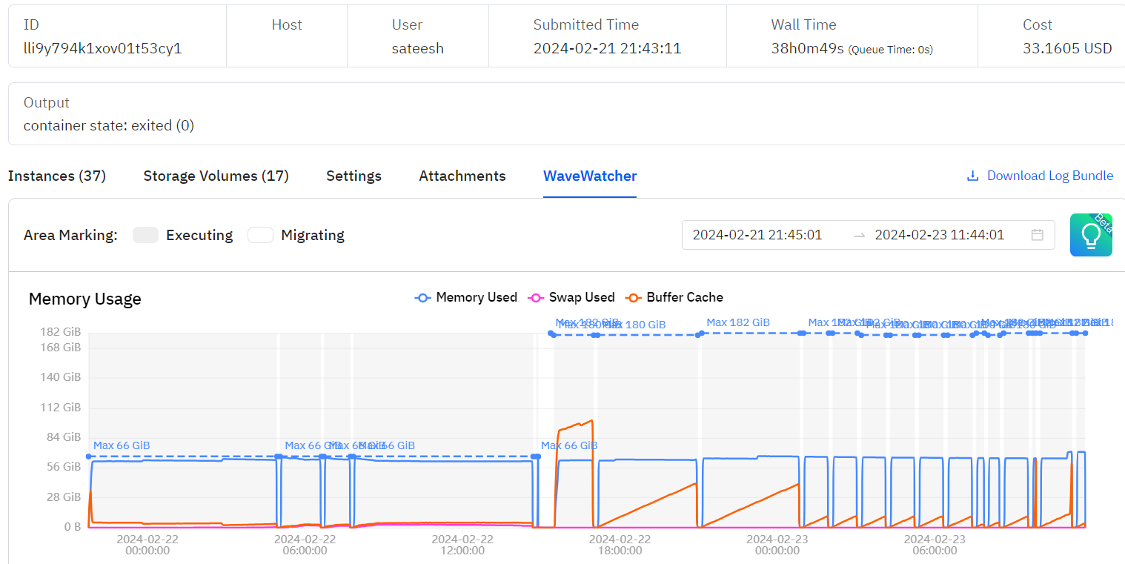
Memory Machine = Spot Reclaim Immunity
Sample: Axolotl Runtime: 38hrs, 49 secs EC2 Instances: 37 Spot Instances
Workflow: Nextflow Process: NFCORE-ATACSEQ-ATACSEQ-FASTQ-ALIGN-BWA-BWA-MEM
Notes:
Using the AppCapsule feature, OpCenter automatically moves a job running on a Spot Instance to a new Spot Instance if the first Spot Instance is reclaimed, as illustrated in the figure.

Slide 11
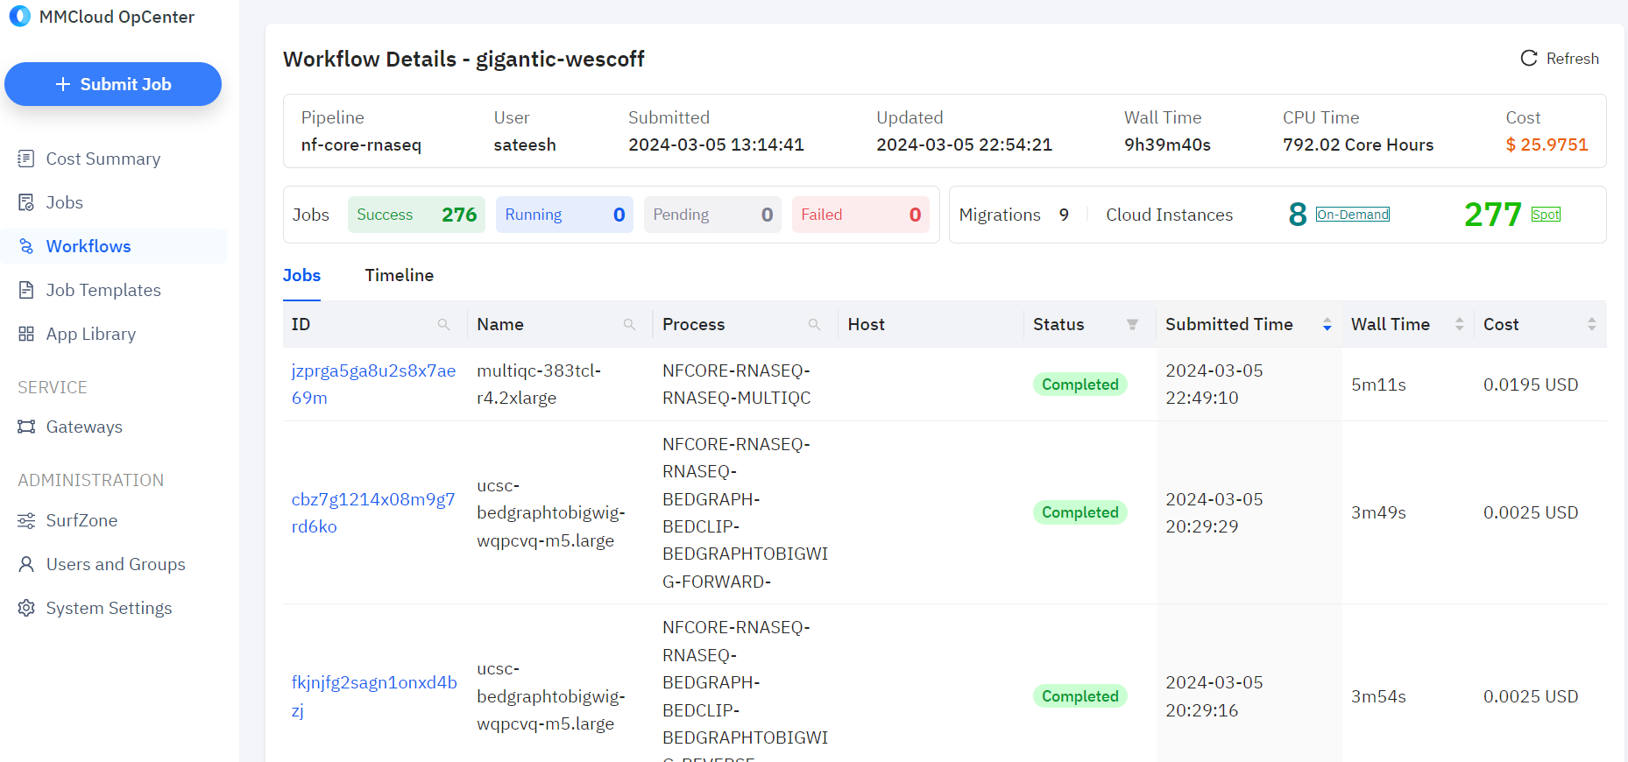
How is my Nextflow pipeline run going?
Notes:
Opcenter: https://docs.memverge.com/MMCloud/latest/User%20Guide/Getting%20Started/opcenterui/

Slide 12
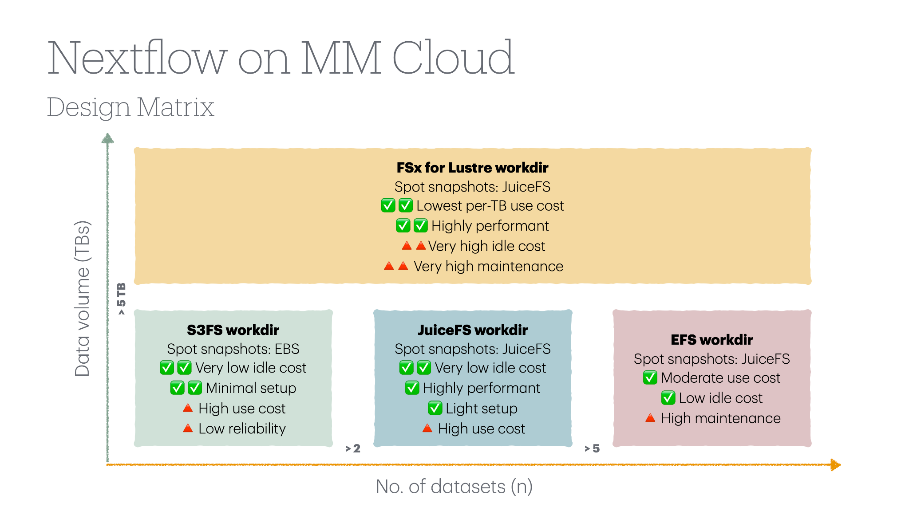
Use the right file system for various workloads without getting vendor locked
Notes:
not locked in to the vendor file system (e.g., seqera fusion file system lock-in)

Slide 13
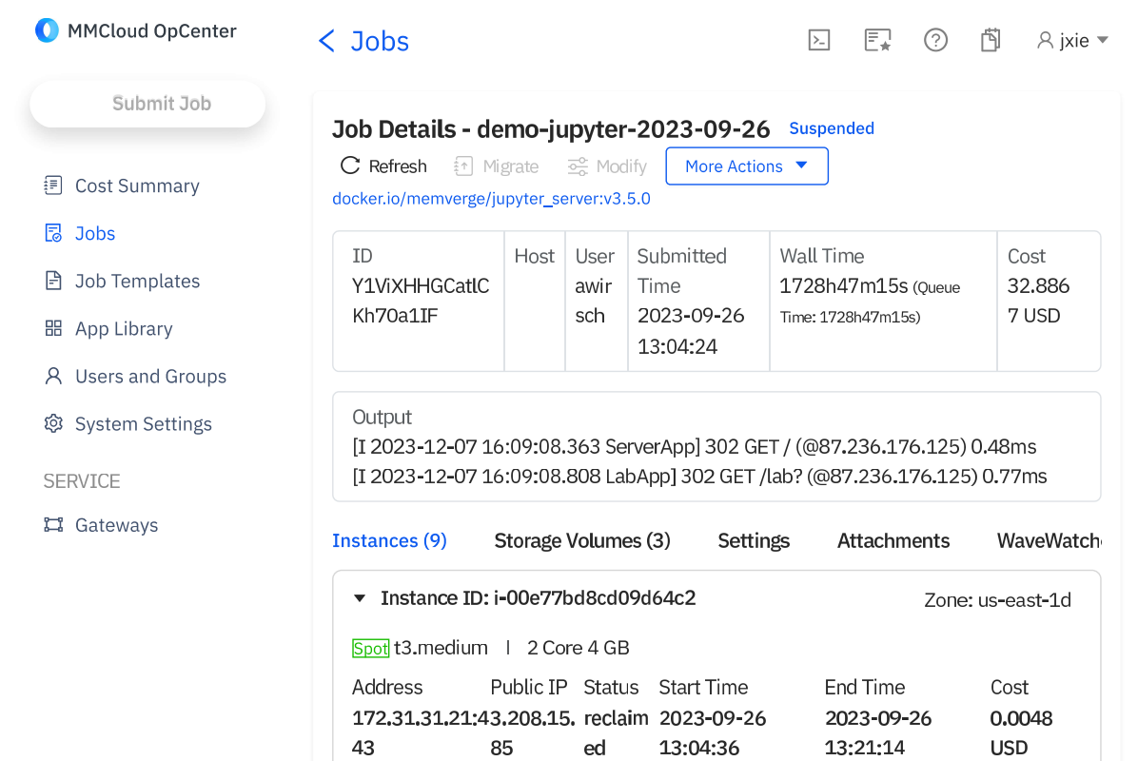
Jupyter notebooks that can EC2 Spot-Surf
72 days running continuously on AWS EC2 for less than your daily coffee
Notes:
jupyter on spot is cheap and efficient; thus you could be running a ton of notebooks and analyses for a long time without incurring lots of hidden costs; memverge's biggest customer Columbia University is a super user of this

Slide 14
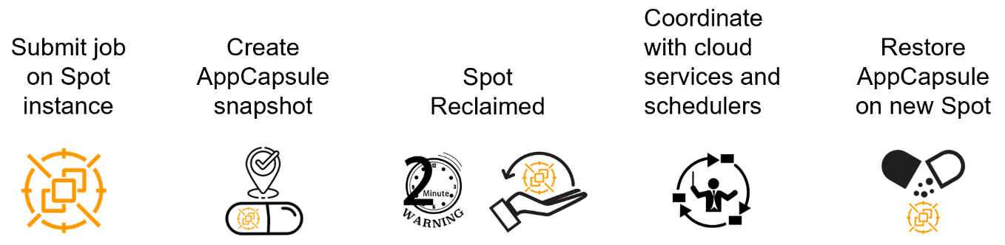
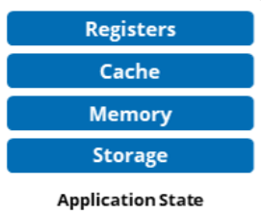
How does it work?
Memory Machine provides an automated checkpoint recovery service called SpotSurfer that enables long-running batch and even stateful apps to run on low-cost Spot instances
Deploy job on Spot instance
Spot Reclaim Notice
Create AppCapsule
Provision a new Spot instance
Restore on new Spot instance
Automated
If no Spot instances are available SpotSurfer can recover using on-demand instances
Notes:
https://docs.memverge.com/MMCloud/latest/User%20Guide/Exploring%20MMCloud%20Features/SpotSurfer/

Slide 15
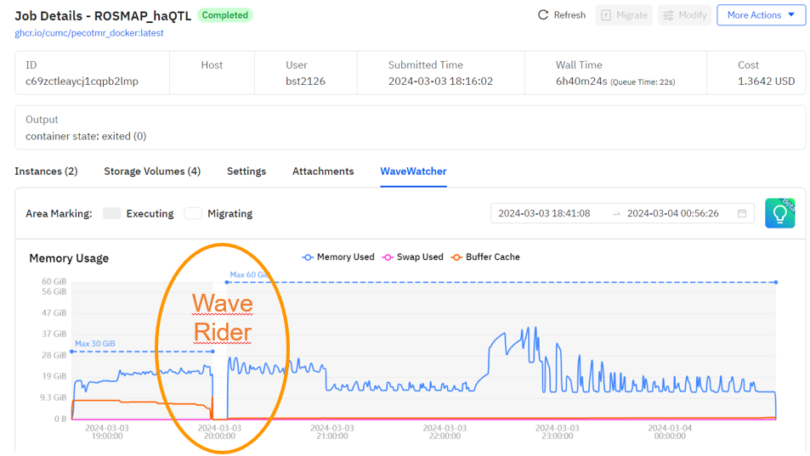

Have you ever run out of memory?
Memory Machine provides an automated service called WaveRider that migrates workloads to larger or smaller instances based on real-time CPU & memory utilization
On-Demand or Spot Instances
Notes:
https://docs.memverge.com/MMCloud/latest/User%20Guide/Exploring%20MMCloud%20Features/Waverider/waverider/
When enabled, WaveRider allows OpCenter to optimize cloud resources by moving jobs as the resource demands change.
Resource utilization (CPU, memory and storage) is not constant while a job runs. Users face a difficult choice: over-provision and overpay, or under-provision and risk out-of-memory conditions. With WaveRider, users can start with a small virtual machine (VM) and dynamically migrate to bigger VMs (and back down to smaller VMs) as the application demands change during a complete job run.
Job migration is initiated in three ways:
Manual: migration initiated using CLI commands or the OpCenter web interface.
Policy-driven: migration triggered by rules-based policy configured per job (policy based on CPU and memory utilization thresholds).
Programmatic: migration executed at specific program breakpoints defined by job script.

Slide 16
Running Alphafold on AWS for less than $2
Alphafold is an open-source workflow developed by Google Deepmind. Its purpose is to predict protein structure base on the provided protein sequence. Alphafold can be considered as two parts: MSA search(rely on CPU) and inference prediction(heavily rely on GPU)
7ktt -- 1142 residues
7FC7 -- 96 residues
Cost per run = $1.22 using MMCloud
85-90% less than alternative options…
Notes:
7ktt - https://www.rcsb.org/structure/7KTT
https://www.rcsb.org/structure/7FC7 7FC

Slide 17
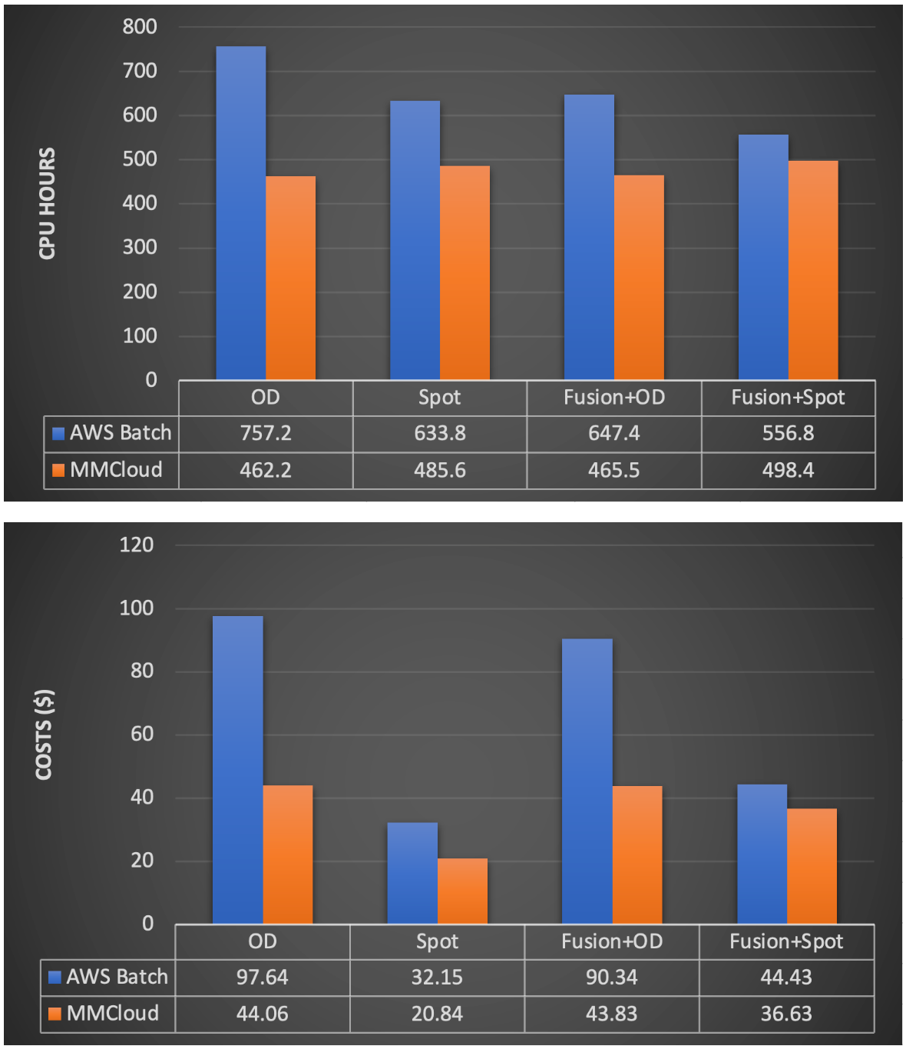

Benchmarking nf-core/rnaseq
MemVerge delivered equal or better rnaseq performance and cost without the use of a commercial file system called Fusion from Seqera
MemVerge’s superior EC2 automation and selection logic outperformed AWS Batch when comparing both “OD” On-Demand runs and Spot runs
The cost of using MemVerge managed Spot instances for rnaseq was 78.7% lower than using AWS Batch managed On-Demand instances
MemVerge SpotSurfer can guarantee consistent CPU hours and cost per run on Spot instances at scale while AWS Batch cannot (see next slide)
78.7% Savings

Slide 18
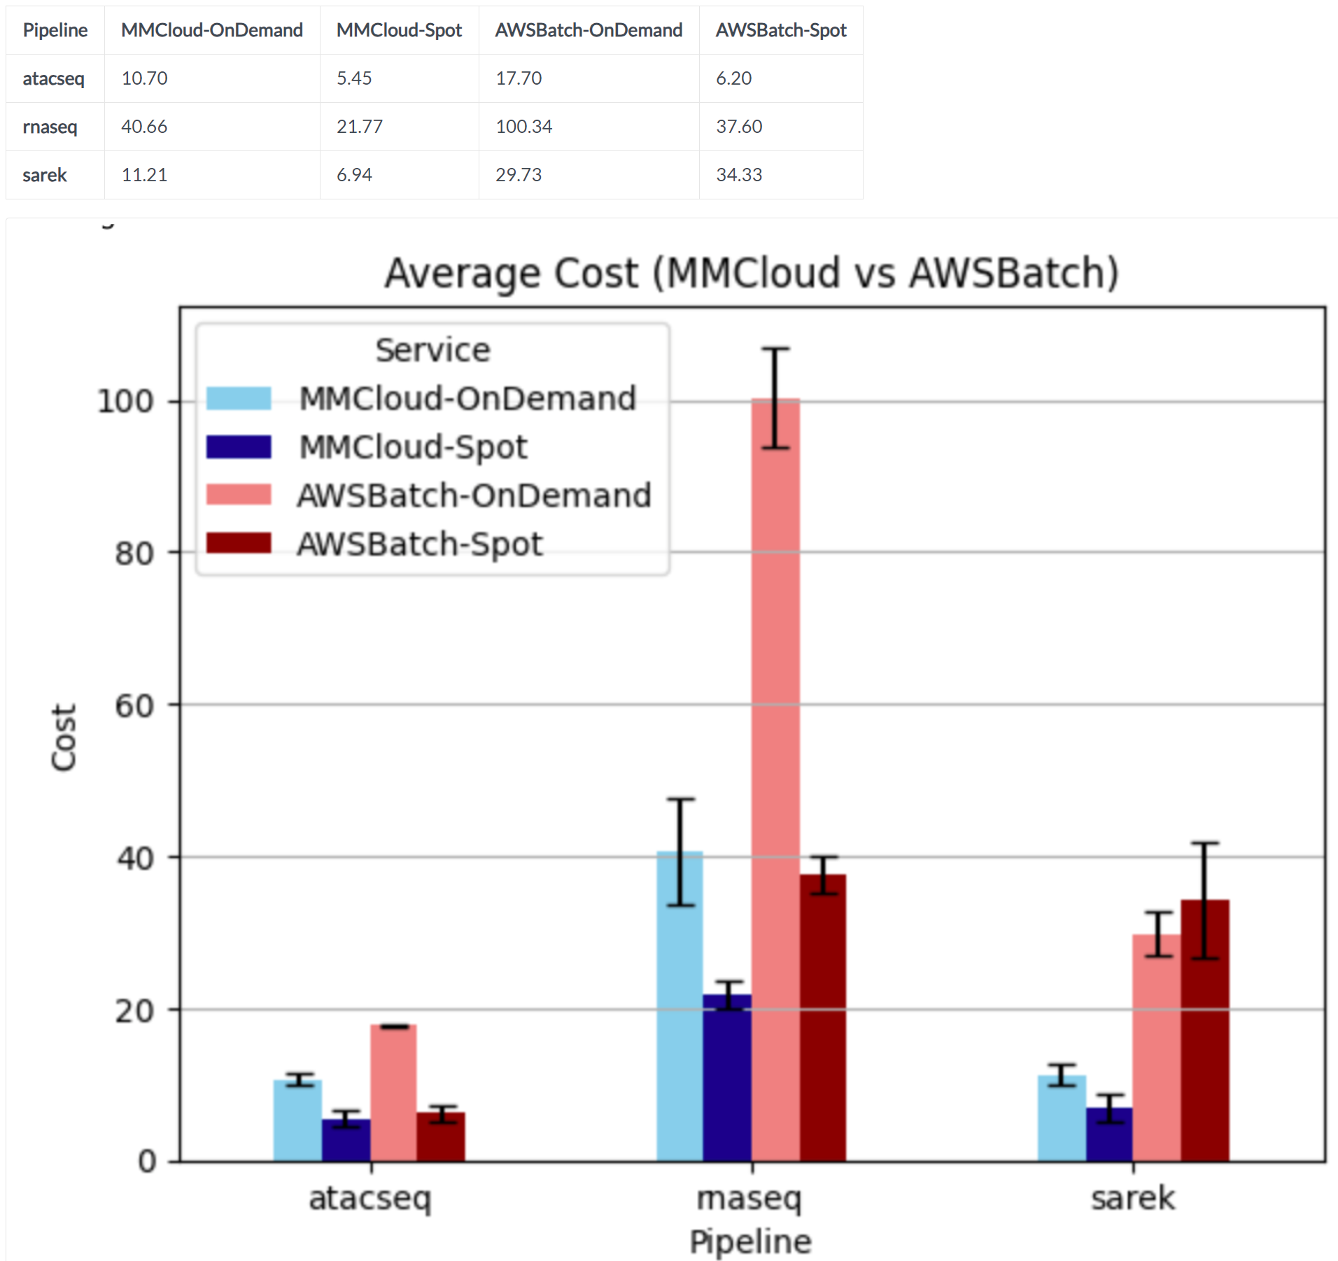
Benchmarking nf-core cont’d…
MemVerge’s superior EC2 automation and selection logic outperformed AWS Batch when comparing both “OD” On-Demand runs and Spot runs
The cost of using MemVerge managed Spot instances for ranged from 69% to 78% lower vs AWS Batch managed On-Demand instances
MemVerge SpotSurfer can guarantee consistent CPU hours and cost per run on Spot instances at scale while AWS Batch cannot (see Sarek data)
69-78% Savings

Slide 19
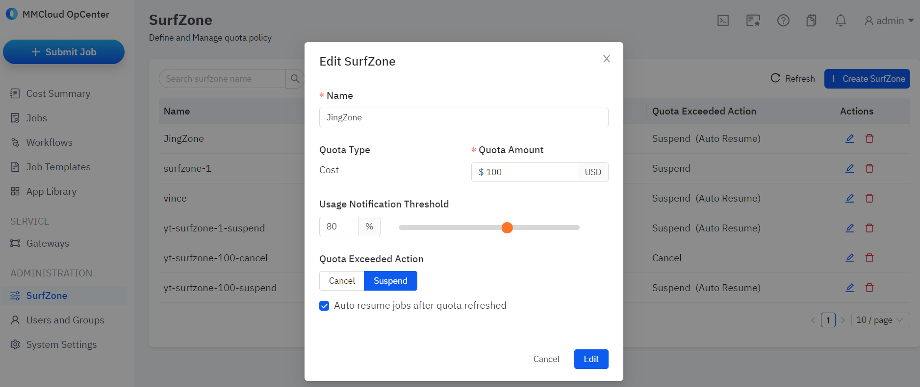
Have you ever had AWS billing surprises?
Memory Machine SurfZone is a service that minimizes the risk of runaway compute spend by cancelling or suspending jobs when a user’s “quota” is exceeded

Slide 20
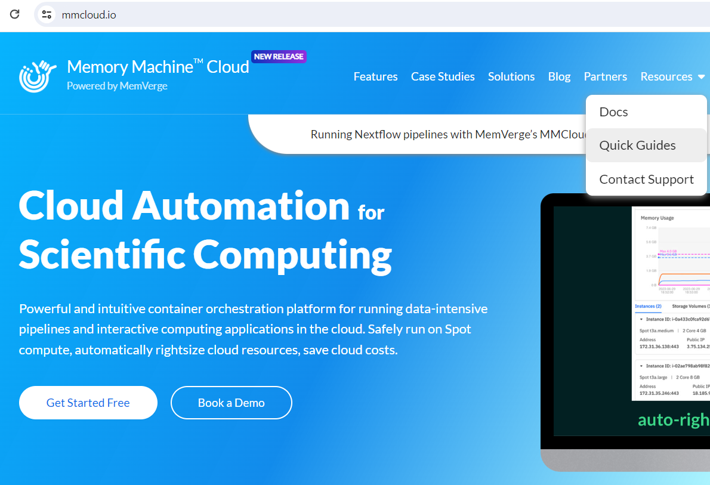
Interested? Here’s how to get started!
Thank you!
Email Jing for more info: jing.xie@memverge.com
Quick start guides: www.mmcloud.io
If you have questions or want to collaborate, problem solve, etc., please reach out!
saba.nafees@memverge.com
Sign up for a free trial
Slack support is available to all users
https://www.mmcloud.io/customer/register

Slide 21
Supplementary

Slide 22

Pain Point: Cloud Skills
Cloud Computing comes with a learning curve
-How do I “submit a job” on AWS, GCP?
-How do I know I’m using the right compute?
-How can I optimize and run this job for less?
-How do I monitor my lab’s job(s) and user(s)?
-How can I do the above in a more automated way?

Slide 23


How MemVerge MMCloud Cuts Cloud Costs
“WaveRider” VM auto-right-sizing
5-10%
EC2 automation, instance selection
5-10%
High perf file system automation
5-10%
Suspend / Resume / Gateway
5-10%
“SpotSurfer” vs. On Demand
50%
50-90%

Slide 24
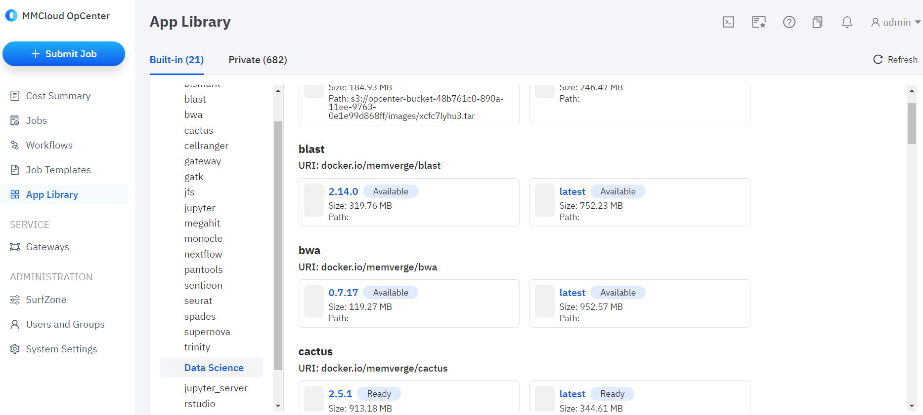
Easily run containerized apps, tools on AWS

Slide 25
Customer testimonials
“MMCloud has helped our team in the Computational Biology Core at MDI Biological Laboratory better utilize AWS Spot EC2 instances to save cloud computing costs. In addition, the WaveWatcher tool has let us observe resource usage in real time, providing new insights into optimizing resource allocations for our work with Nextflow pipelines”
-Joel Graber, Director of the Computational Biology and Bioinformatics Core
“We have been impressed by the performance of the WaveRider for Sentieon solution. Early testing shows 4-5x speed-ups out-of-the-box and we expect to improve the results as we fine tune the solution. Faster processing coupled with leveraging Spot instances is dramatically lowering our cloud costs too. This solution enables us to complete our NGS more efficiently than ever and will help elevate our research to a new level.”
-Remco Ursem, Program Leader of Bioinformatics
“I was getting up to 80% batch failure rates with Spot EC2, now with SpotSurfer we have already brought failure rates due to Spot reclaims to below 1%, and we are just getting started. WaveRider picks the most appropriate VM for each of the thousands of jobs launched by Nextflow. That is giving me more efficiency than ever. Very cool.”
-Vince Pagano, Senior Scientific Programmer

Slide 26


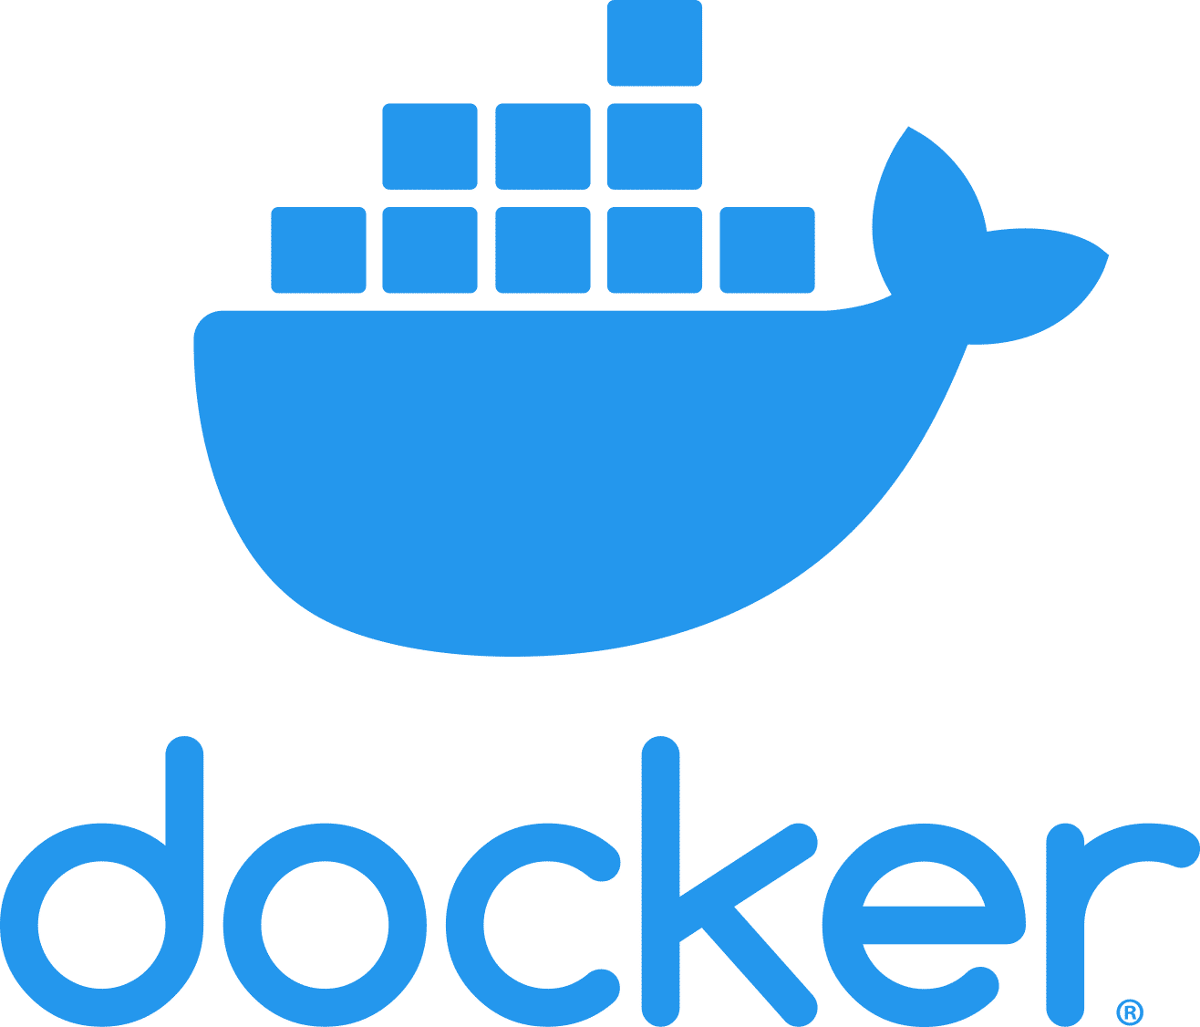













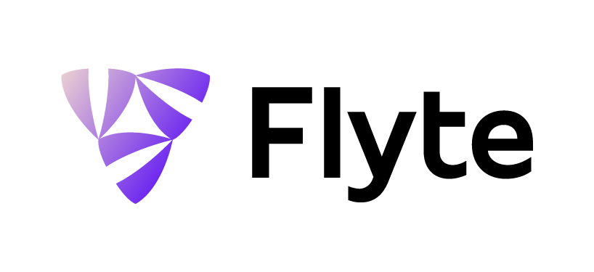

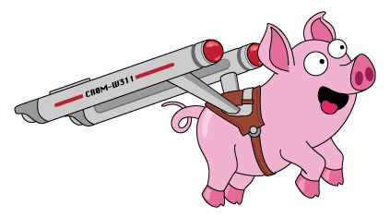
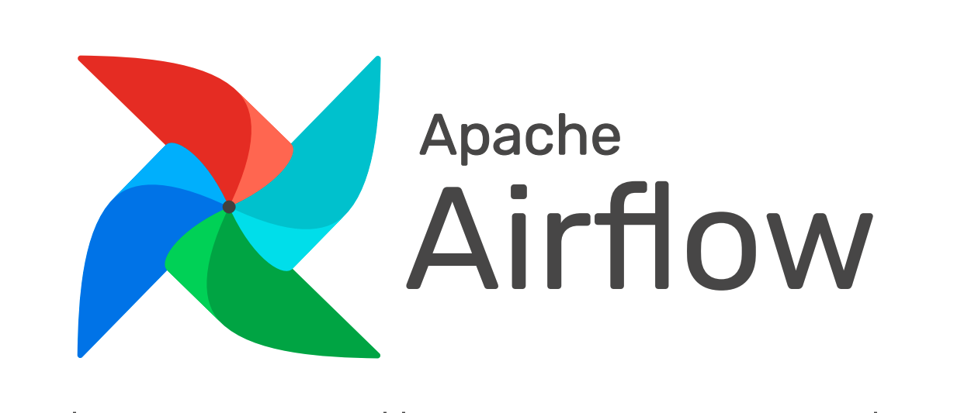




Full Stack Solution or Embeddable
Memory Machine Operations Center (in user Cloud account)
VPC
Float Command Language / Graphical User Interface
Restful API
Container
Image
Repository
Users
Resource Manager
Job Manager
App Library
+
Scheduler
Snapshot
AppCapsule
AutoSave
Rollback
Thin Clones
SpotSurfer
WaveRider
WaveWatcher
Registry
Integrations
Worker Node
Worker Node
Worker Node
Job
Job
Job
Agent
Agent
Agent
EC2 Instances
EC2 Instances
EC2 Instances
Internet
Gateway
App Temp Storage
I/O Data
App Temp Storage
I/O Data
App Temp Storage
I/O Data

Slide 27
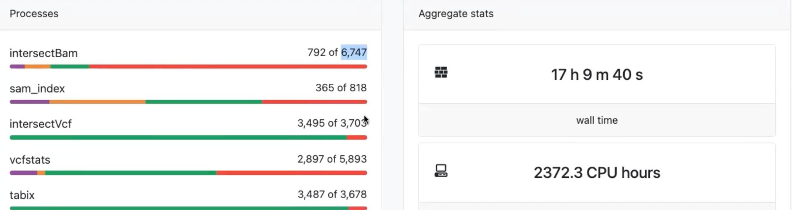


Case Study: Leading Genomics Research Institute (TGen)
Background:
Large 501(c)(3) research institution focused on accelerating genetic research was struggling to cost-effectively run Nextflow on AWS
Pain Points:
Huge # of worker nodes, > 20K+ VMs per workflow
~75% failure rate using when using Spot EC2
Solution:
Memory Machine Cloud on AWS
Results:
70% EC2 savings
Reduced Failure Rate to Zero
Real-time automated EC2 optimization
Integration
SpotSurfer
Spot Protection
Memory Machine Differentiators
WaveRider
Resource Rightsizing
Current implementation supports scaling to 1,000 concurrent worker nodes per Memory Machine Op Center, larger solutions can be supported via multiple Memory Machine Op Centers.

Slide 28
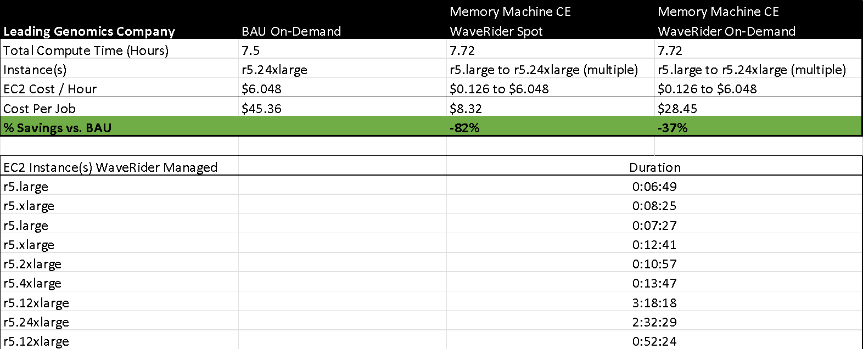
Case Study: Leading Genomic Medicines Company
Background:
Large biotech pioneering the future of genomic medicine with multiple clinical and pre-clinical product pipelines
Pain Points:
Limited IT budget, multiple days to get compute spun up for researchers
No easy way to refactor pipelines and cost-optimize for running in the cloud
Solution:
Memory Machine Cloud on AWS
Results:
>35% cost savings w/ On-Demand EC2
>80% cost savings w/ Spot EC2
AWS resource provisioning in seconds vs. days

Slide 29
Optimizing AWS resources
Reduce the # of spot attempts under the hood
Error strategy
Retry
Ignore
Tell nextflow to go from spot to ondemand after 1 attempt so that resource consuming tasks can be done via ondemand
spot instance
ondemand
Notes:
These are various ways in which seqera engineers helped me optimize compute for the pipelines I was running. Spot Instances: unused EC2 instances, which can reduce your Amazon EC2 costs significantly. On-Demand Instances: Pay for the instances that you use by the second, with a minimum of 60 seconds, with no long-term commitments or upfront payments.

